Slide 1
INTERACTIVE NOTBOOK topic: STATISTICS class: teacher: Semester 2, Term 3

Slide 2
Contents
Glossary or Formula Page
Page
Date
Description
Word
Description
2
3

Slide 3
Tasks
24
7
30
Topic
Essential Question
Questions
Notes
Summary
8
9

Slide 4
24
7
30
Measuring the Centre of Data
Date
EQ – How do we measure the centre of the data?

Slide 5
Quickwrite
2 minutes
LEFT HAND SIDE
What do you know/remember about
‘measuring the centre of data’

Slide 6
Activity
- stand up, hands up, pair up
John purchased 5 computer games at a sale.
2 games cost $20 each, 2 games cost $30 each and 1 game cost $50
What do you remember about mean, median and mode?
2) Can you work out the mean, median and mode?
3) Which of the mean, median, mode gives the best ‘average’?
Notes:
Remind students how participate responsibly in this activity
Students in pairs work through each question (1 at a time)
Can swap partners between each question?

Slide 7
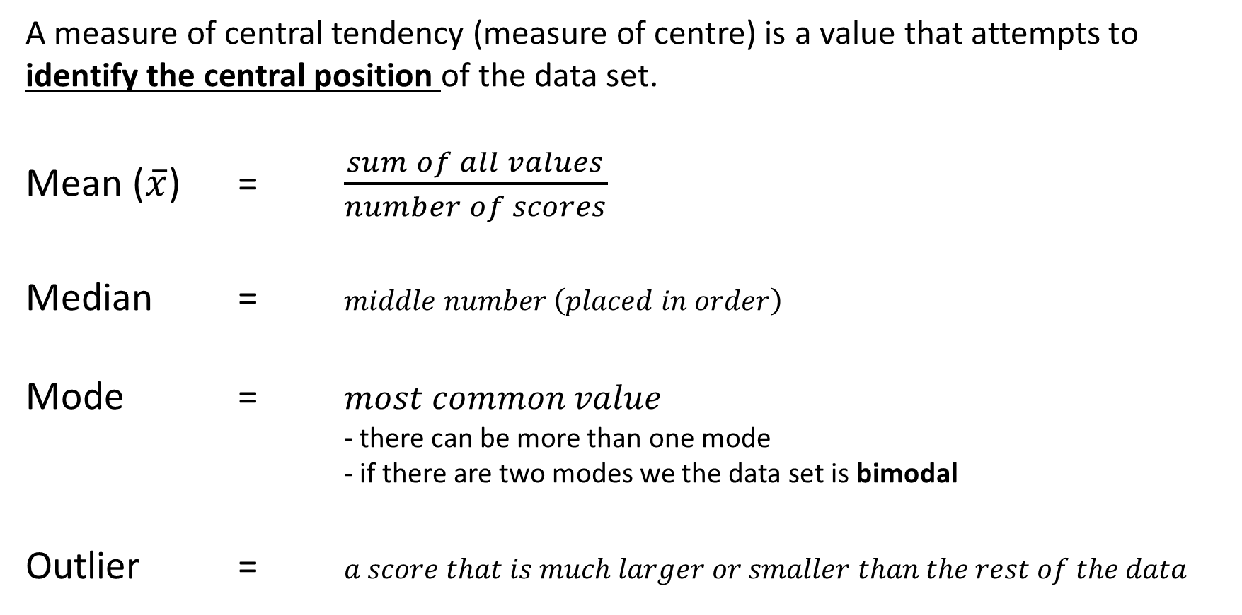
24
7
30
Measuring the Centre of Data
Date
EQ – How do we measure the centre of the data?
A measure of central tendency (measure of centre) is a value that attempts to identify the central position of the data set.
Mean ($\overline{x}$) = $\frac{sum of all values}{number of scores}$
Median = $middle number \left(placed in order\right)$
Mode = $most common value$
- there can be more than one mode
- if there are two modes we the data set is bimodal
Outlier = $a score that is much larger or smaller than the rest of the data$
How can we better describe the data?

Slide 8
24
7
30
Measuring the Centre of Data
Date
EQ – How do we measure the centre of the data?
Example:
4 , 5 , 8 , 10 , 7 , 9 , 8
Mean =
Median =
Mode =
4 , 5 , 7 , 8 , 8 , 9 , 10

Slide 9
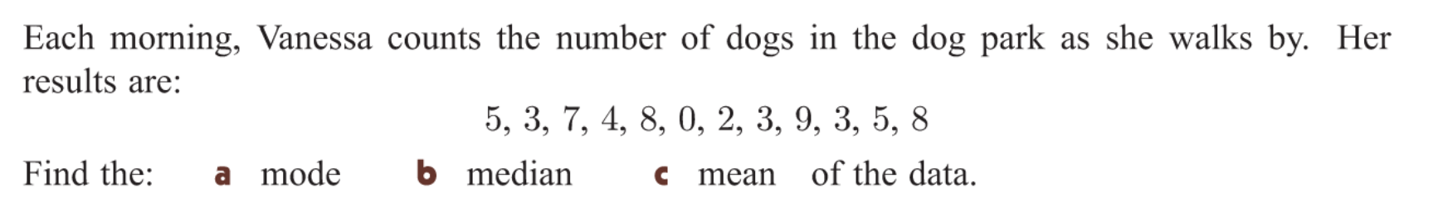
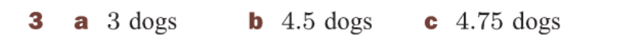
Task
YOUR TURN

Slide 10
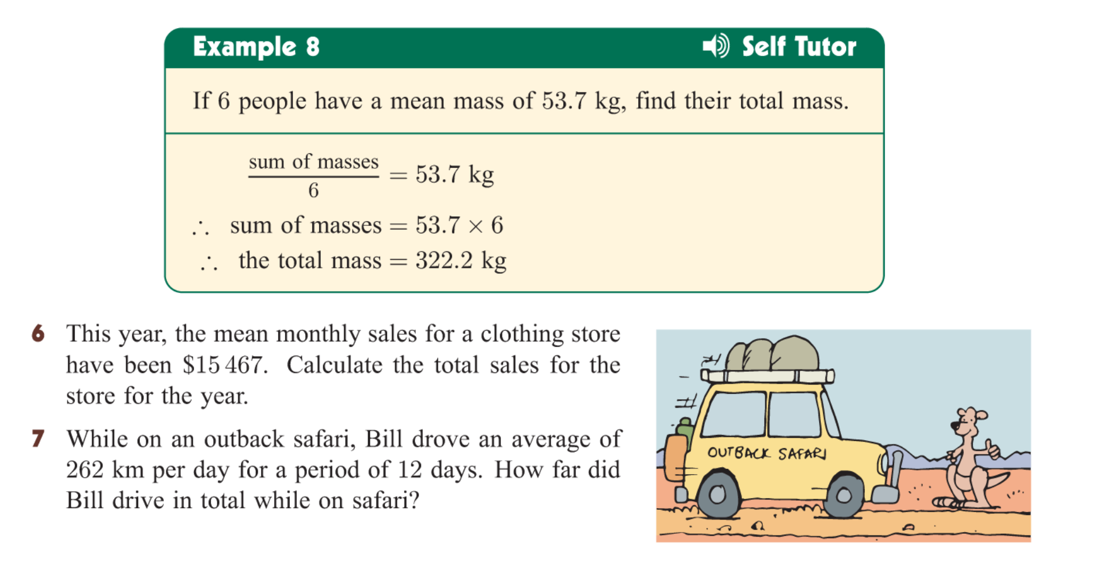
With the person next to you….. How would you solve it?

Slide 11


Slide 12
TASK
ESSENTAL MATHS
CHAPTER 9G (pg 537)
Q3)
Q4)
Q5)
Q7)
Q10) a , b

